Slide 1
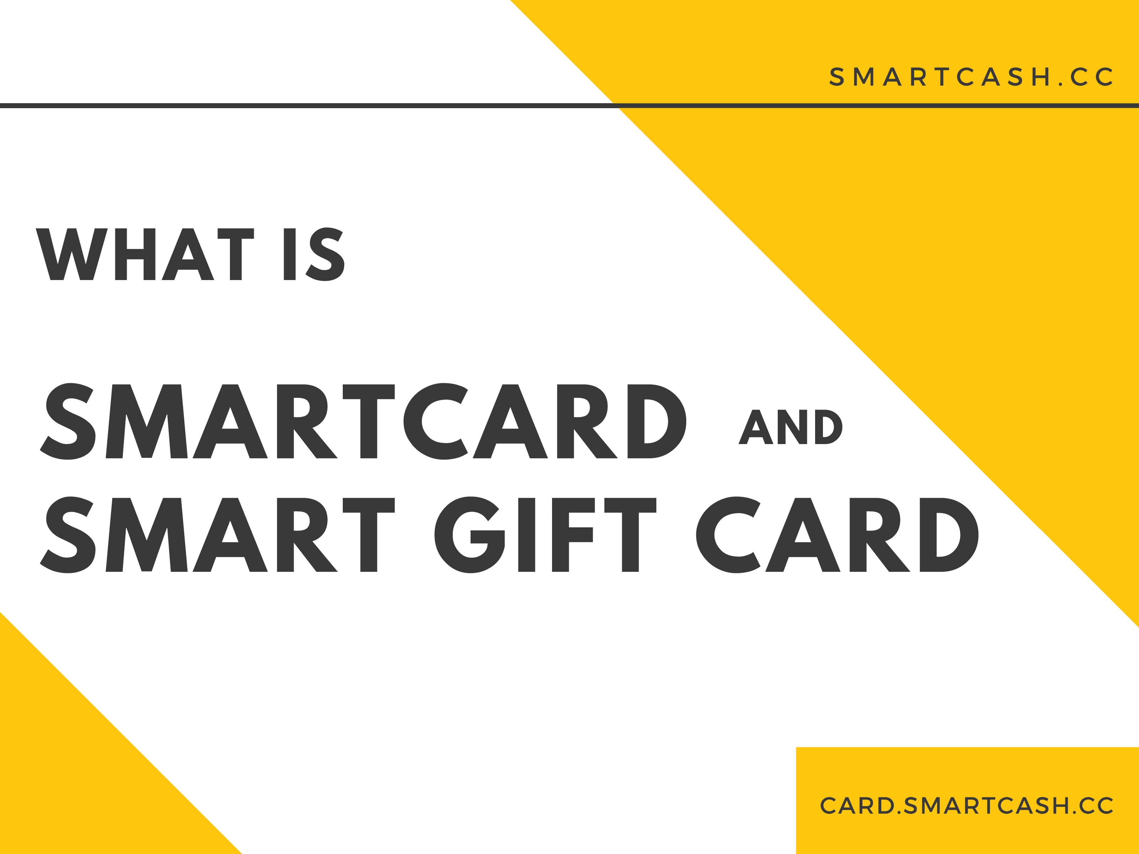

Slide 2

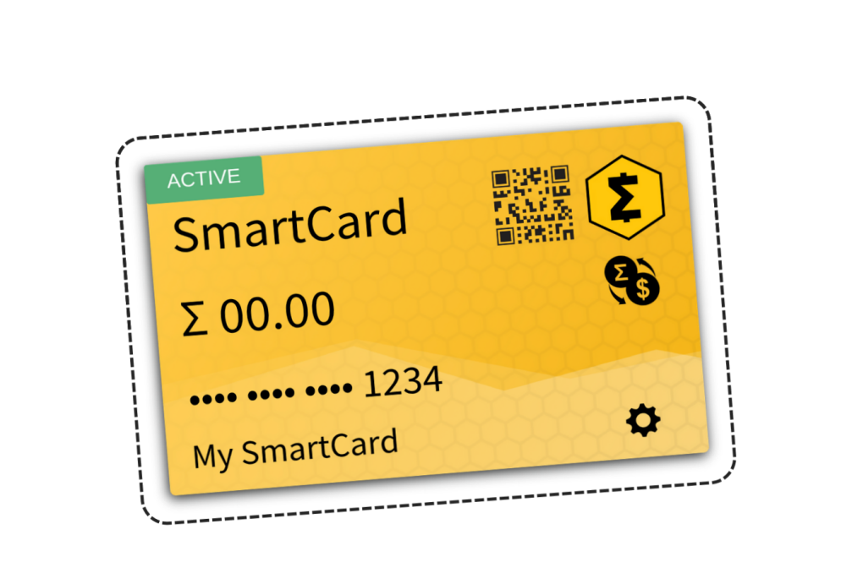
INTRODUCTION
SmartCard is a blockchain-based solution that aims to improve on the digital payment card model.
The SmartCard makes it possible to pay with SmartCash using a physical card where no mobile wallet or phone internet access is required.

Slide 3
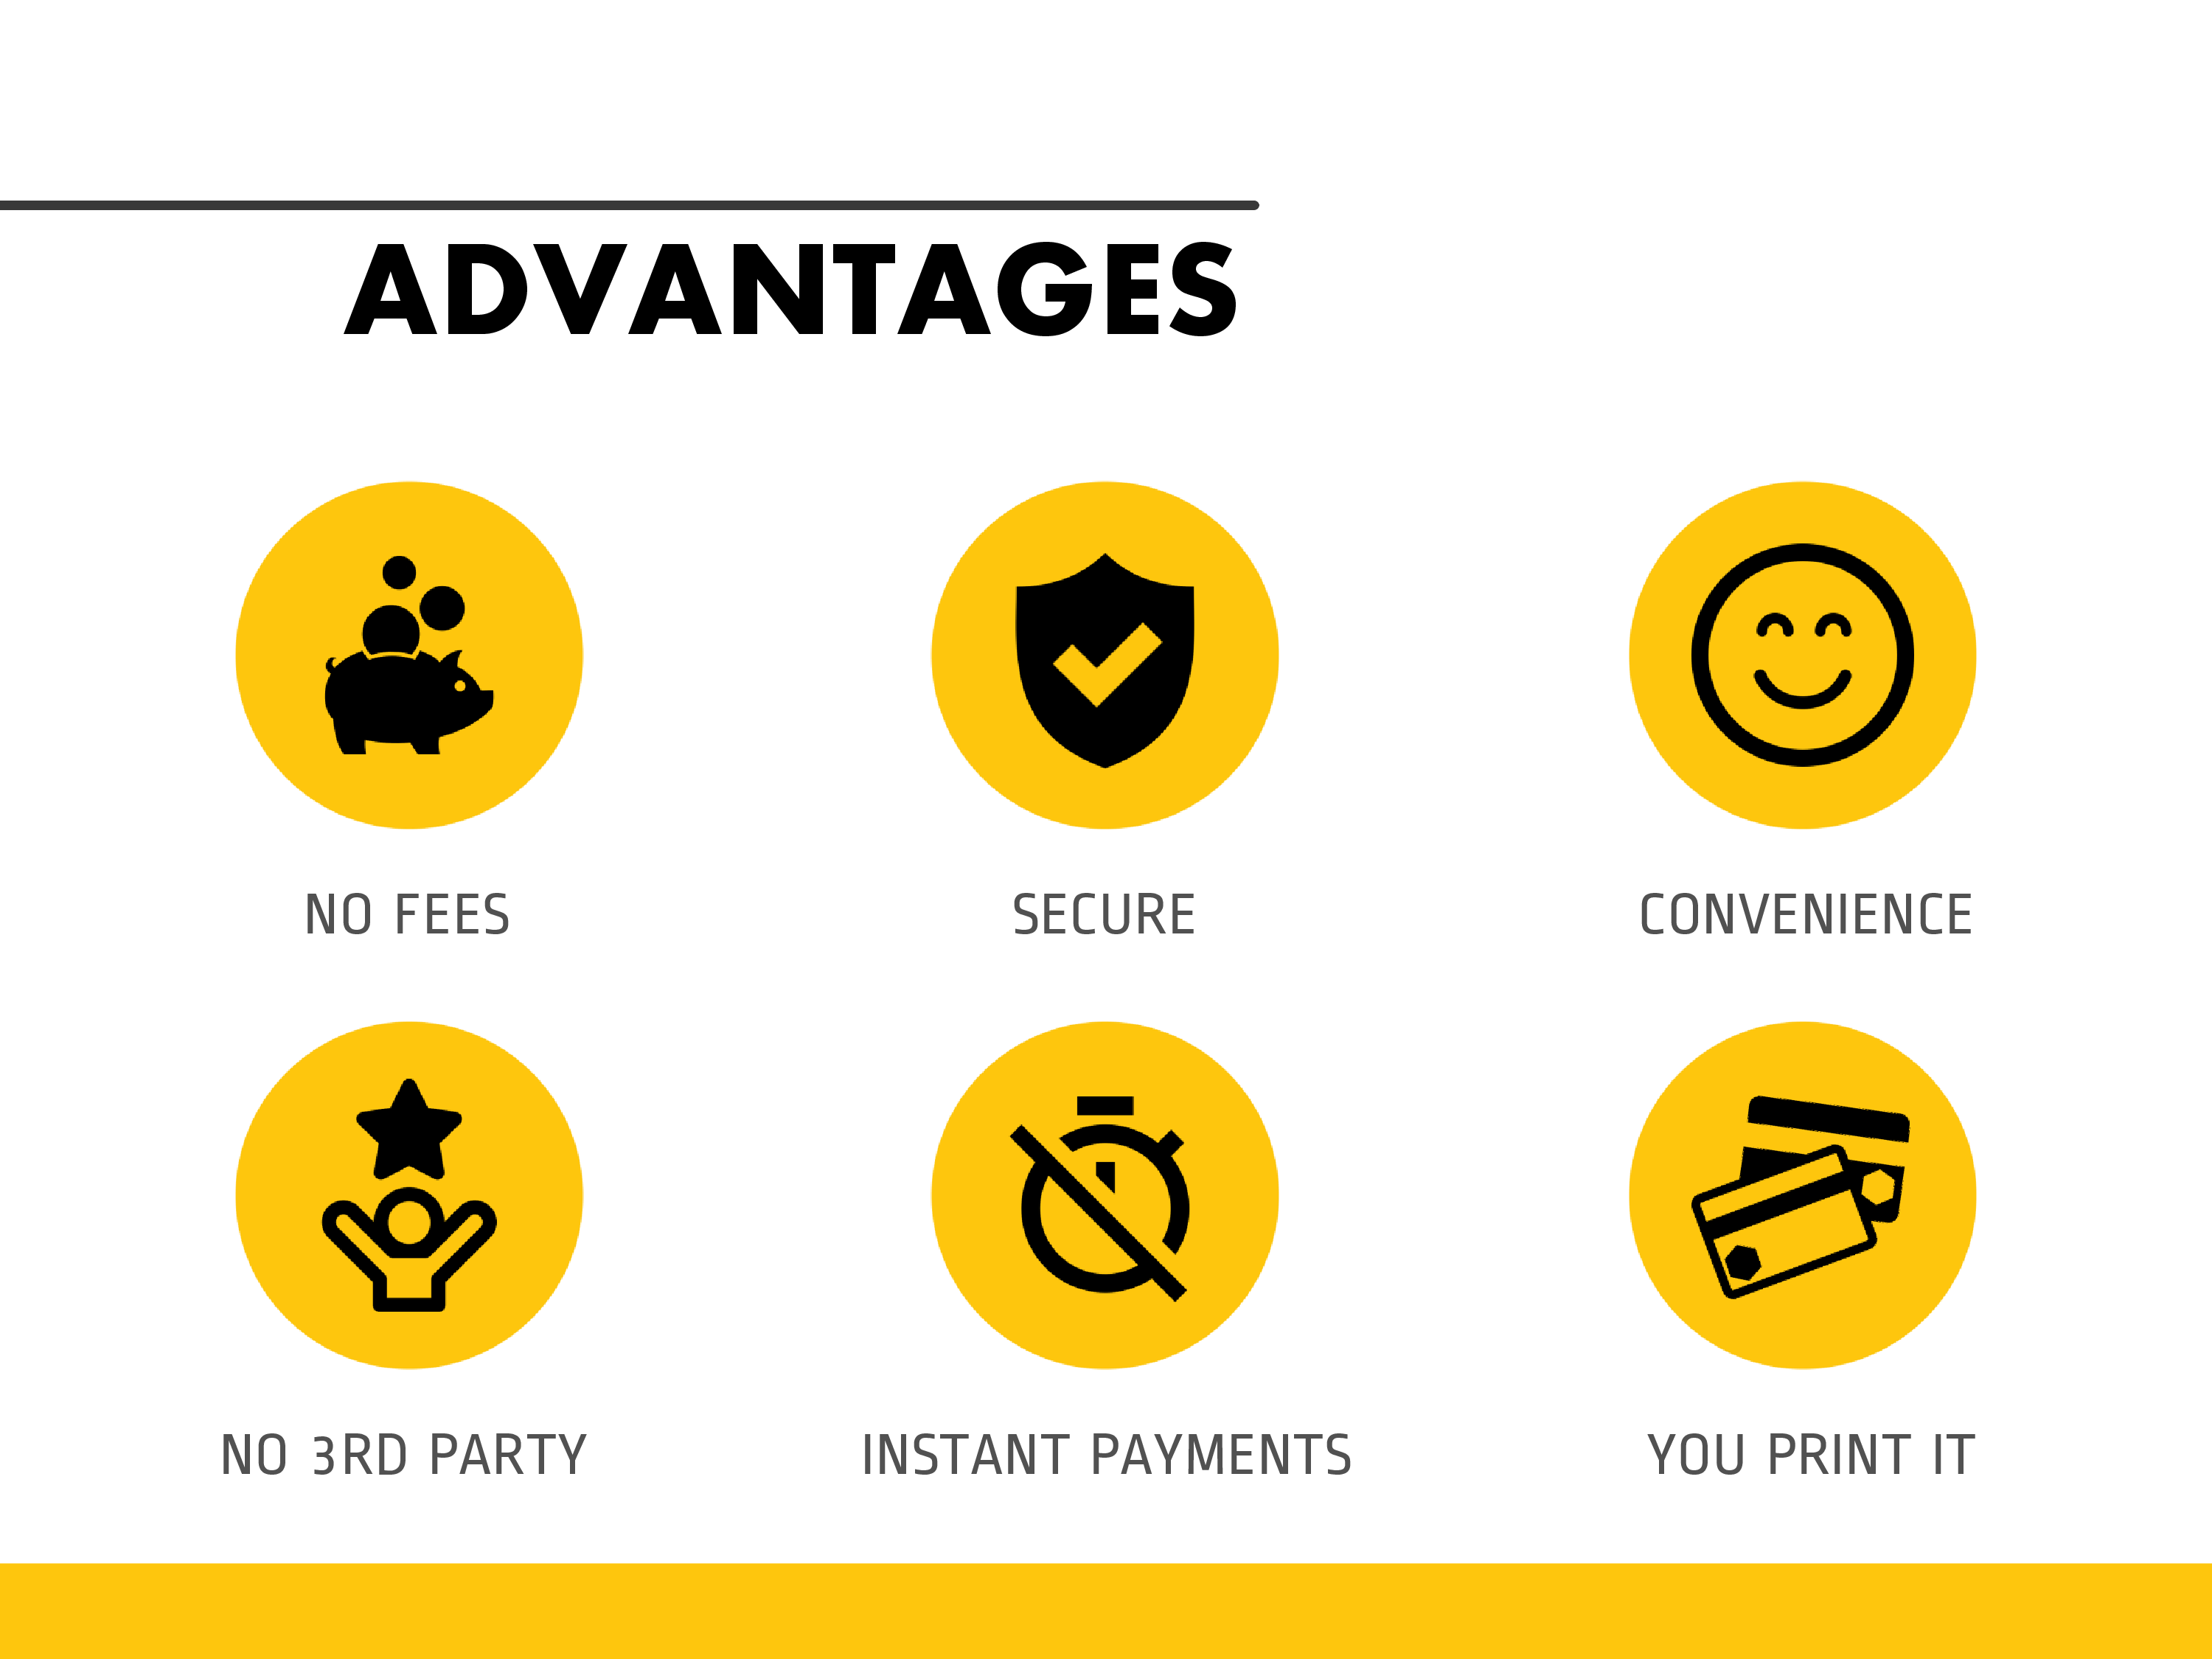








ADVANTAGES
NO FEES SECURE CONVENIENCE
No 3rd Party Instant PaymentS You Print It

Slide 4

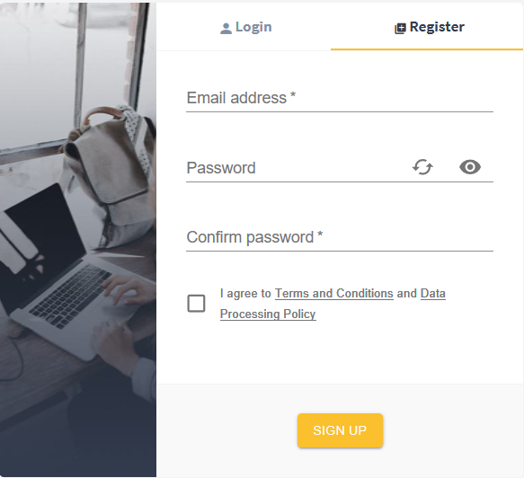

SmartCard
How to create your own
Go to card.smartcash.cc and create your account
Confirm email address
Click on "Add New Card"
Set PIN
Save card details
Top up your card with SmartCash
Print your SmartCard
You're ready to pay!

Slide 5
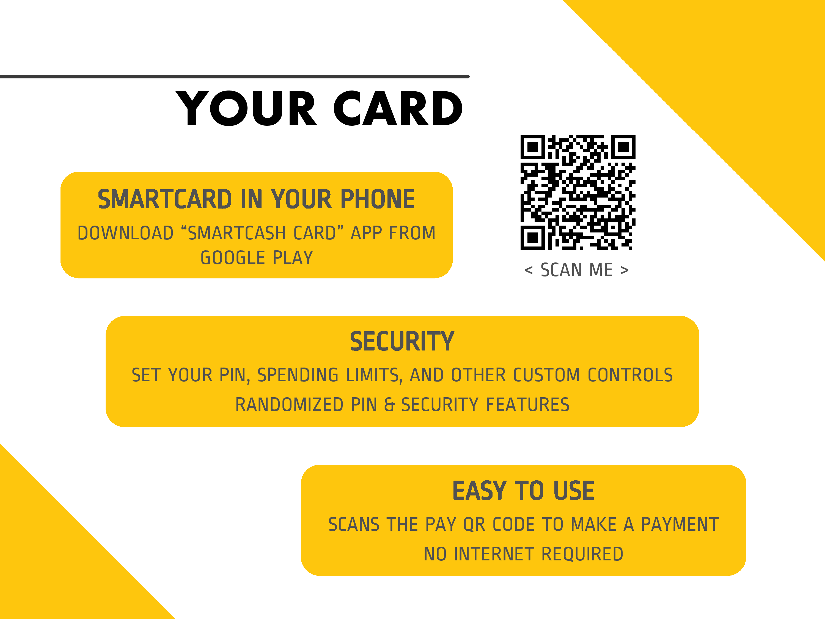
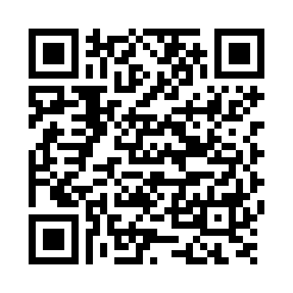
Your Card
SmartCard in your phone
Download “SmartCash Card” app from Google Play
< Scan me >
Security
Set your PIN, spending limits, and other custom controls
Randomized PIN & Security Features
Easy to use
Scans the Pay QR code to make a payment
No Internet Required

Slide 6
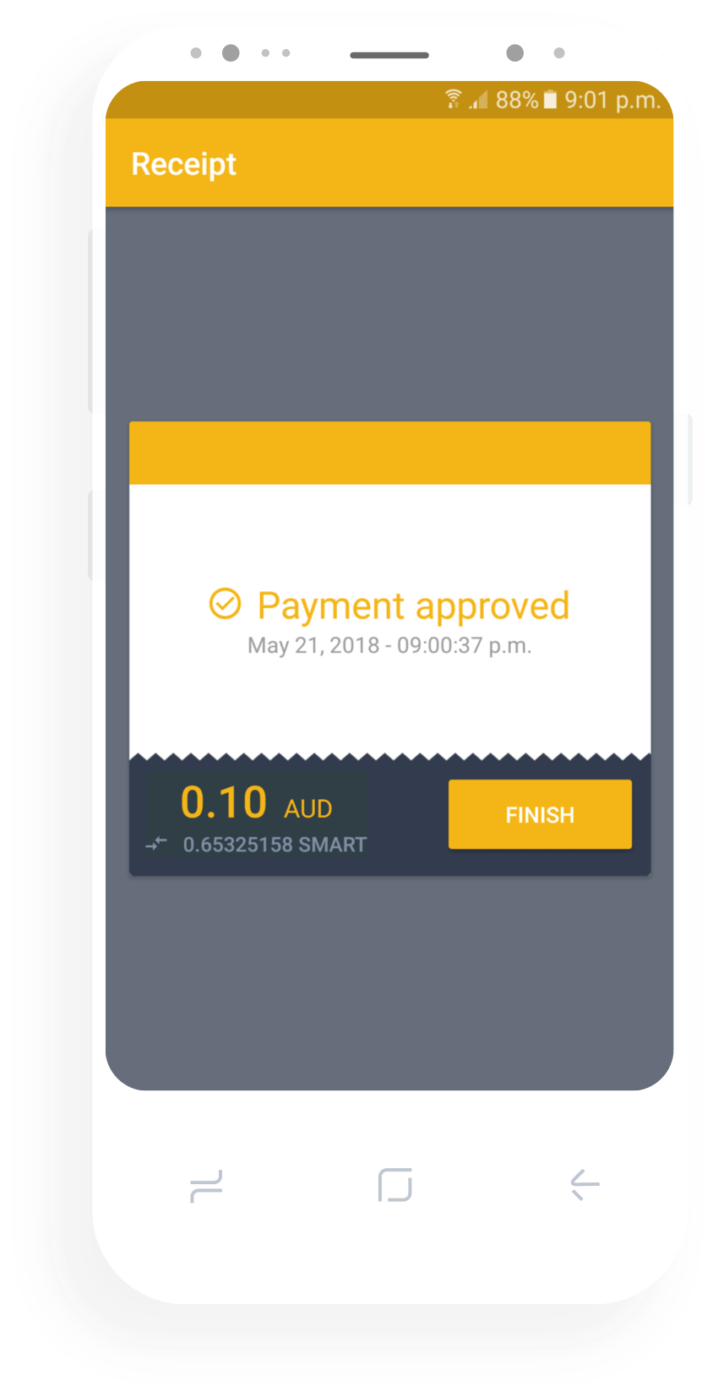
How to use
1
Deposit SmartCash into your card front QR Code "Deposit"
2
Let staff know you are paying with SmartCard so they scan your card back QR Code "Pay"
3
Confirm payment by verifying your card name and entering your PIN

Slide 7
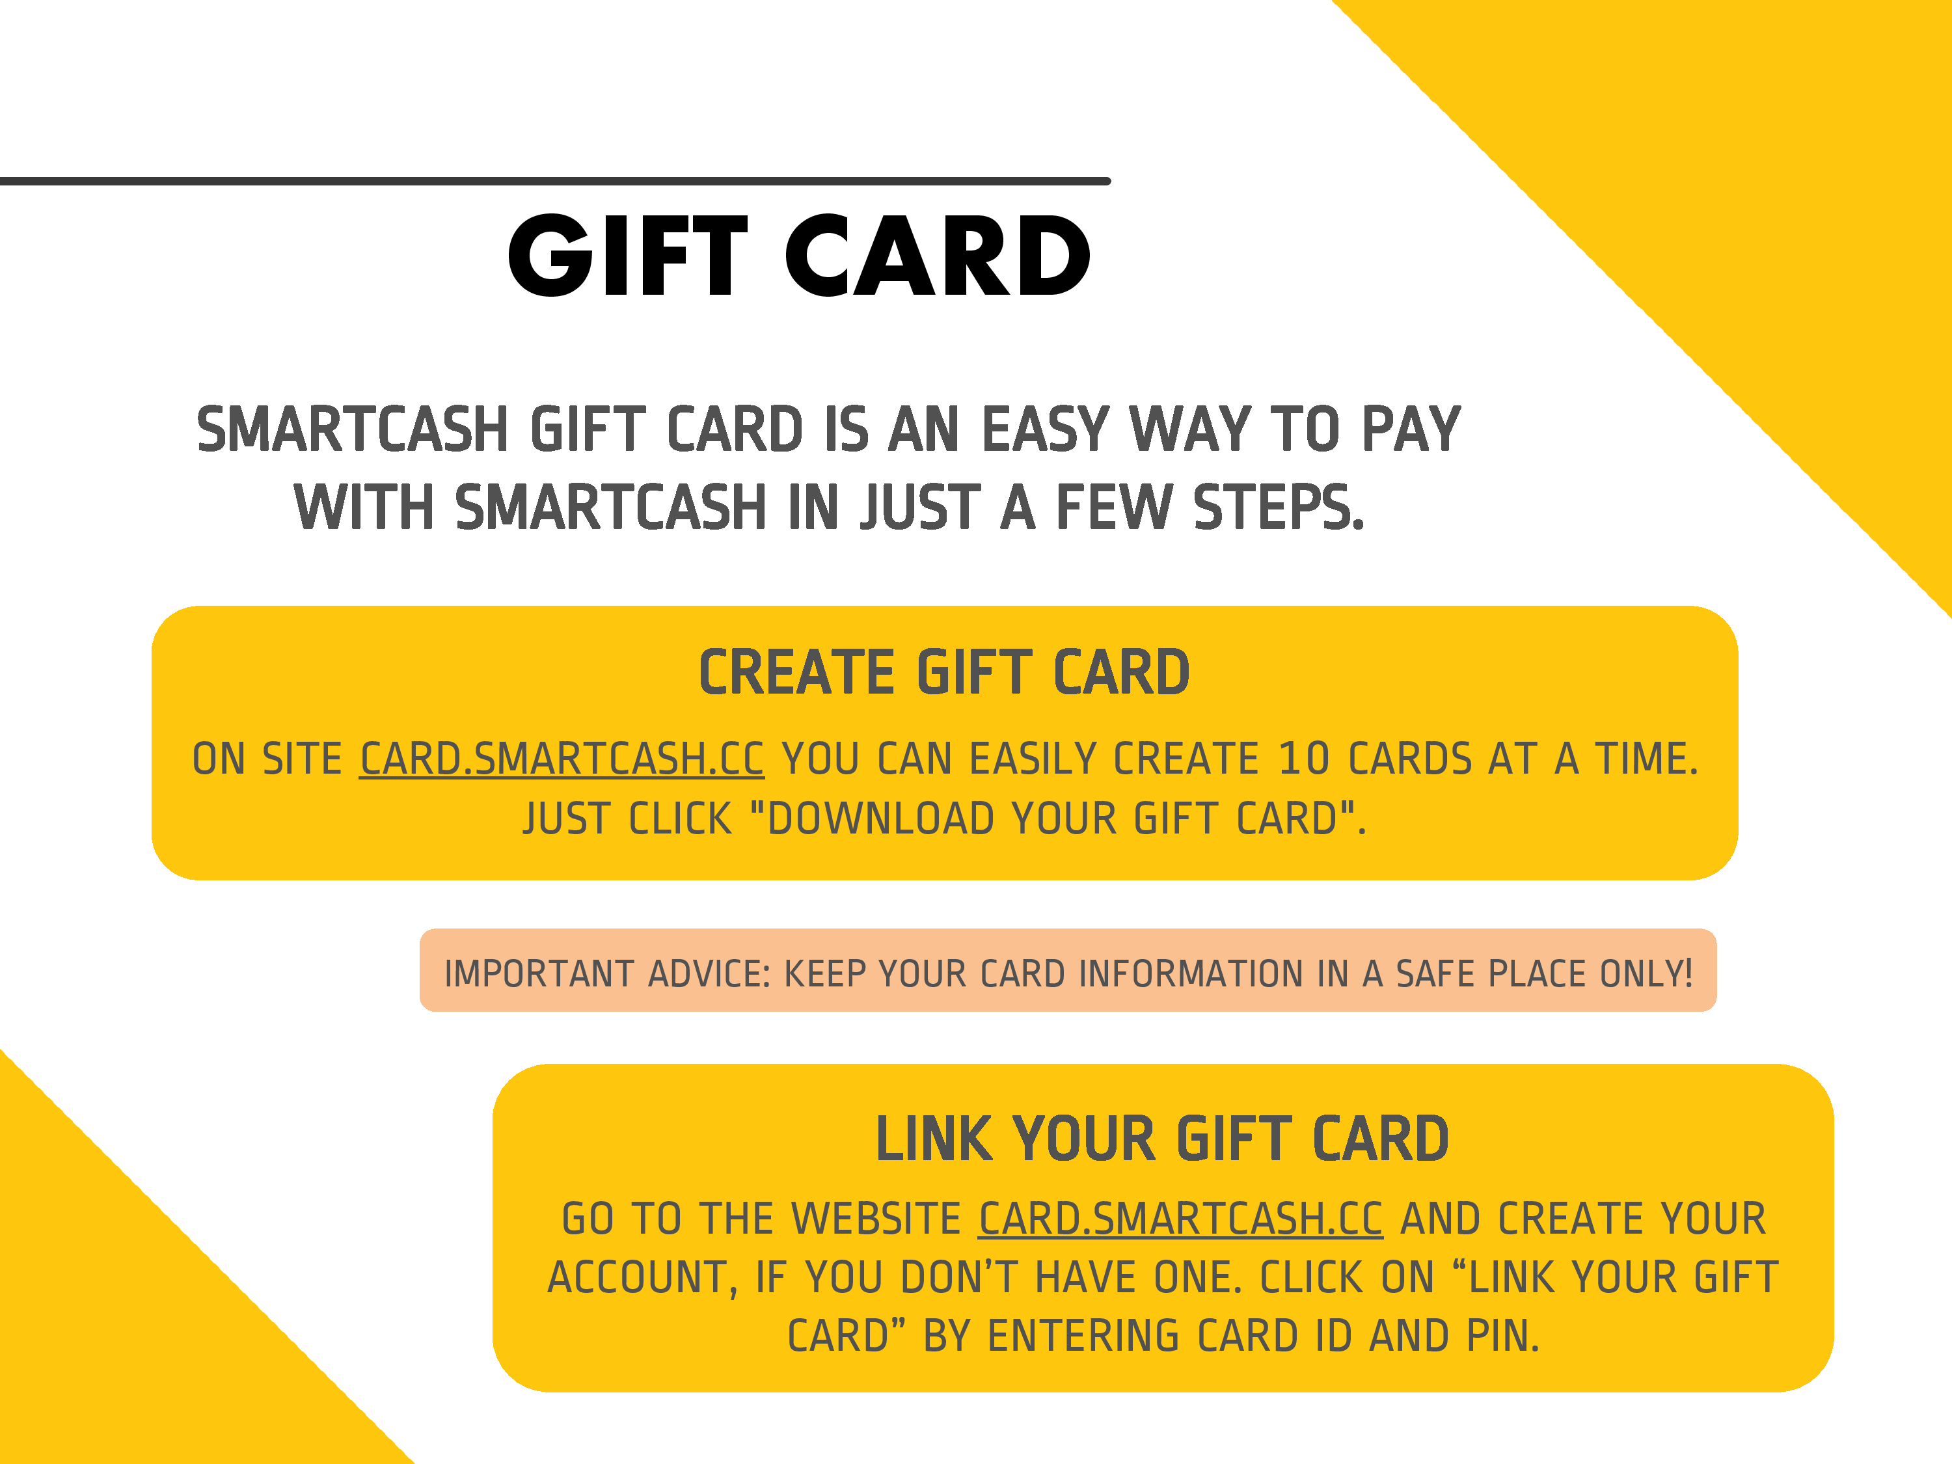
Gift Card
SmartCash Gift Card is an easy way to pay with SmartCash in just a few steps.
Create Gift Card
On site card.smartcash.cc you can easily create 10 cards at a time. Just click "Download your Gift Card".
Important advice: Keep your card information in a safe place only!
Link your Gift Card
Go to the website card.smartcash.cc and create your account, if you don’t have one. Click on “Link Your Gift Card” by entering Card ID and PIN.

Slide 8
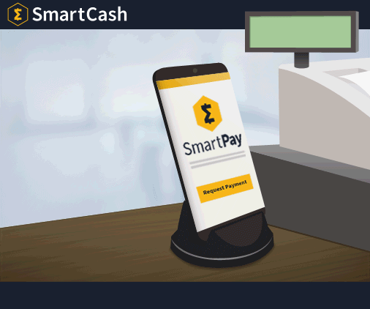
SmartPay for Business
For stores that do sales and transactions in-person - you can use simple SmartPay app.
Register your business at business.smartcash.cc

Slide 9






CONTACT US!
@scashofficial discord.smartcash.cc
smartcashchat hello@smartcash.cc

